Slide 1
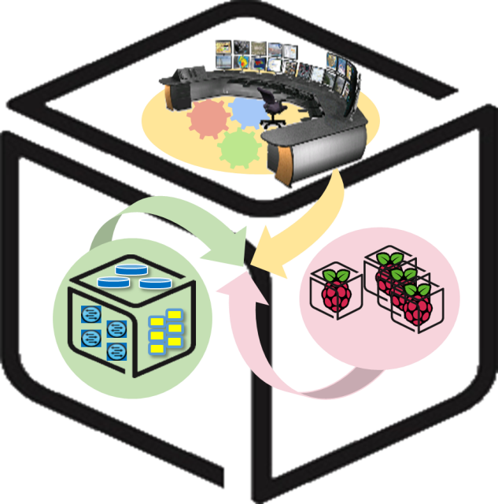



Computer Systems
For AI-inspired Cloud
Theory & Lab.
Lab #2: Inter-Connect
https://github.com/SmartX-Labs/SmartX-Mini-MOOC

Slide 2












Inter-Connect Lab: Concept
Kafka broker cluster
Hypriot OS
Ubuntu Linux
Raspberry Pi
NUC

Slide 3
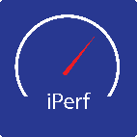
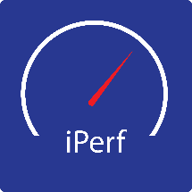







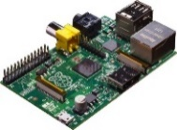
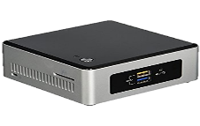
Physical Inter-Connect
iperf Client
iperf Client
iperf Server
Container
Docker
Runtime
VM
C
TCP Packet
KVM Hypervisor
Hypriot OS
Linux Ubuntu OS
Switch
Raspberry Pi Box
for IoT Sensors
& Actuators
NUC Box
for IoT-Cloud Hub

Slide 4





Data Inter-Connect
Timestamp, IP Address, Value1, Value2, …
Timestamp, IP Address, Value1, Value2, …
Timestamp, IP Address, Value1, Value2, …
…
Timestamp, IP Address, Value1
Timestamp, IP Address, Value1
….
Kafka Cluster
Topic 1 (Load Average)
……
Topic 2
(Memory Utilization)
Topic 3
(CPU Utilization)
Topic 4
(IO)

Slide 5



Theory

Slide 6
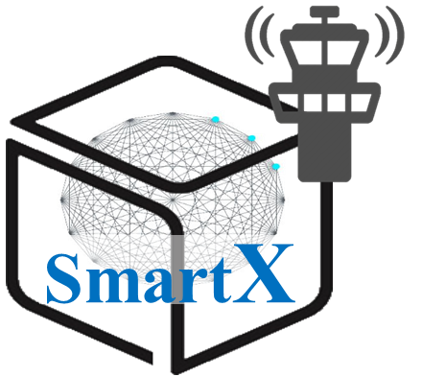



Computer System: Inter-Connected Functions inside/across Boxes/Sites
Resources – Workloads - Services
Functions
Box
Site
Inter-Connect

Slide 7
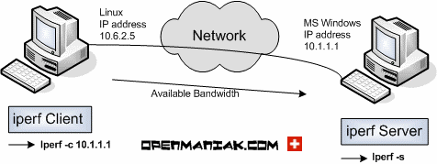
Inter-Connect Test: iperf
Simply measures the maximum transmission capacity (bandwidth) in the wired / wireless network communication section
Transmits the maximum traffic from Client node to the Server node and displays the result.
Support TCP, UDP, SCTP and so on.
Support variety of options
-s : iperf server
-c : iperf client
-i : check interval time
-t : total check time
http://sfixer.tistory.com/entry/iperf-The-Easy-Tutorial

Slide 8

Kafka Messaging System
Kafka Cluster
TCP Protocol
broker1
TCP Protocol
Consumer
Producer
Broker2
(Leader)
broker3
Zookeeper
Cluster
Provides the functionality of a messaging system, but with a unique design
Topics: maintains feeds of messages in categories
Producers: processes that publish messages to a Kafka topic
Consumers: processes that subscribe to topics and process the feed of published messages
Broker: run as a cluster comprised of one or more servers
Zookeeper
Producers(Pi #1)
Node 0 (Master)
Broker 0
Producers(Pi #2)
Node 1 (Slave 1)
Broker 1
Consumers
(Spark Streaming)
. . . . . . . .
Node 2 (Slave 2)
Broker 2
Node 3 (Slave 3)
Broker 3
Producers(Pi #20)

Slide 9

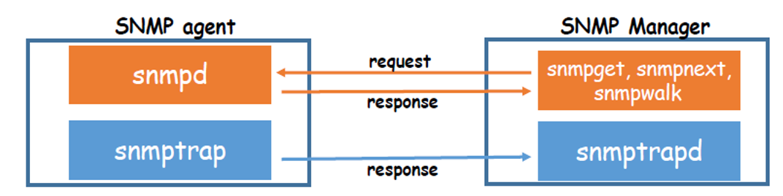

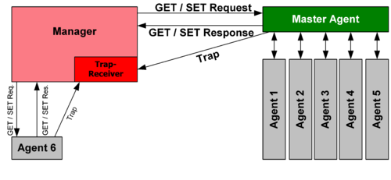
Net-SNMP: SNMP Agent/Manager
A suite of software for using and deploying the SNMP Protocol
Manager : polls agents on the network, correlates and displays information
Agent : collects and stores information, responds to manager requests for information, generates traps
(Simple Network Management Protocol): Used in network management systems to monitor network-attached devices, which include routers, switches, servers, workstations, printers, modem racks and more

Slide 10

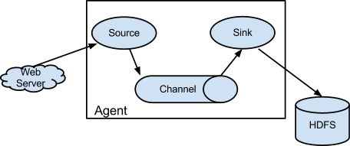
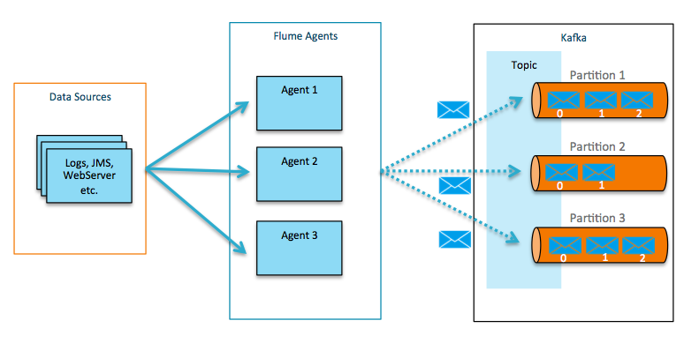
Apache Flume: Log Collector
A distributed, reliable, and available service for efficiently collecting, aggregating, and moving large amounts of log data
Log aggregator with many customizable data sources, which runs asynchronously
Flume Agent
Source consumes events having a specific format
Channel holds the event until consumed
Sink removes an event from the channel and puts it into on external repository or another source

Slide 11
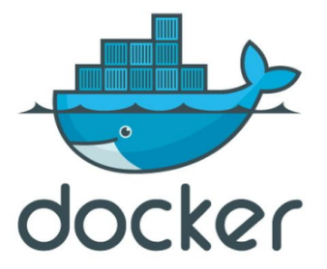
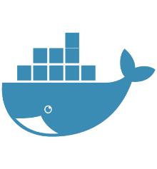
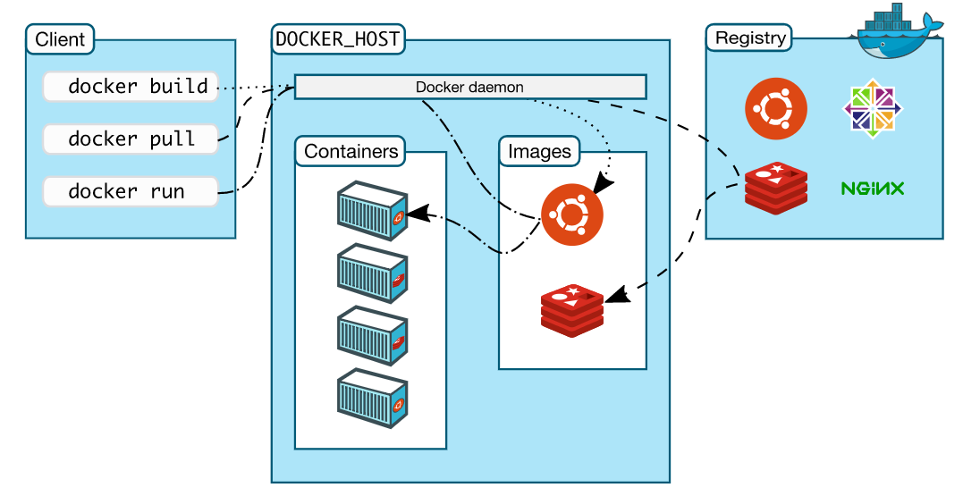
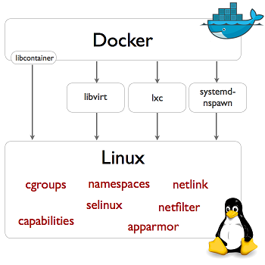
Docker: Light-weight Process (Application) Container
Docker Hub

Slide 12
Practice

Slide 13
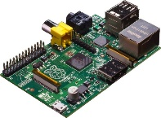
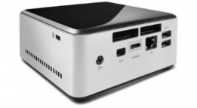


NAME: NUC5i5MYHE (NUC PC) CPU: i5-5300U @2.30GHz CORE: 4 Memory: 16GB DDR3 HDD: 94GB
#0 Lab Preparation (1/4)
Wired connection
NAME: Raspberry Pi Model B (Pi) CPU: ARM Cortex A7 @900MHz CORE: 4 Memory: 1GB SD Card: 32GB
NAME: NT900X3A
CPU: i5-2537U @1.40GHz
CORE: 2 Memory: 4GB DDR3 HDD: 128GB
NAME: netgear prosafe 16 port gigabit switch(Switch) Network Ports: 16 auto-sensing 10/100/1000 Mbps Ethernet ports

Slide 14



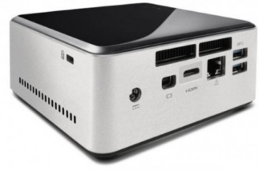


Linux Box with Virtualization/Containers
VM
Container
Tap1
ping test
Virtual Machine
&
Container
br0
eno1
Linux Box

Slide 15

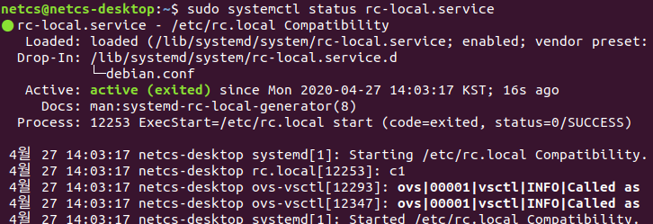
#0 Lab Preparation (3/4)
$ sudo touch /etc/rc.local
$ sudo chmod +x /etc/rc.local
$ sudo vi /lib/systemd/system/rc-local.service
$ sudo systemctl enable rc-local.service
$ sudo systemctl start rc-local.service
$ sudo systemctl status rc-local.service
$ sudo reboot
...........................
[Service]
Type=forking
ExecStart=/etc/rc.local start
TimeoutSec=0
RemainAfterExit=yes
GuessMainPID=no
[Install]
WantedBy=multi-user.target
Check !

Slide 16
#0 Lab Preparation (4/4)
Prepare 3 terminal on NUC
Bare metal, VM, Container
Running and Access to KVM on NUC (Open KVM terminal)
Access to Container on NUC (Open Container terminal)
$sudo kvm -m [memory_capacity] -name [vm_name] \
-smp cpus=[#cpu],maxcpus= [#maxcpu] \
-device virtio-net-pci,netdev=net0 \
-netdev tap,id=net0,ifname= [tap_name],script=no \
-boot d [img_name].img \
-daemonize
$vncviewer localhost:5
$docker attach [container_name]

Slide 17
#1–1 Raspberry PI: OS Installation (1/4)
Before we start, your Raspberry Pi must be ready with proper OS.
In this lab, we will use “HypriotOS” Linux for it.
Eject a MicroSD card from your Raspberry Pi, and insert it into your SD card reader and attach the reader to your NUC.
Issue the commands below to get “flash” script for the OS setup.
Issue “flash” command to see if it’s installed correctly.
$ sudo apt update && sudo apt install -y pv curl python3-pip unzip hdparm
$ sudo pip3 install awscli
$ curl -O https://raw.githubusercontent.com/hypriot/flash/master/flash
$ chmod +x flash
$ sudo mv flash /usr/local/bin/flash

Slide 18
#1–2 Raspberry PI: OS Installation (2/4)
Download HypriotOS configuration files for your Raspberry Pi from GitHub
https://github.com/SmartX-Labs/SmartX-Mini
Download HypriotOs from GitHub (at Downloads folder)
https://github.com/hypriot/image-builder-rpi/releases/download/v1.9.0/hypriotos-rpi-v1.9.0.img.zip
$ cd ~
$ sudo apt-get install -y git
$ curl -s https://packagecloud.io/install/repositories/github/git-lfs/script.deb.sh | sudo bash
$ sudo apt-get install -y git-lfs
$ git lfs install
$ git clone https://github.com/SmartX-Labs/SmartX-Mini.git
$ cd ~/SmartX-Mini/SmartX-Mini-MOOC\ Collection/Experiment/Lab-2.\ Inter-Connect/
$ cp ~/Downloads/hypriotos-rpi-v1.9.0.img.zip ./
$ ls –alh # Check all files

Slide 19
#1–2 Raspberry PI: OS Installation (3/4)
Edit HypriotOS configuration file for your Raspberry Pi.
Let’s open the “hypriotos-init.yaml” file and edit its network section.
The assigned IP address will be automatically applied, when you’re initially booting your Raspberry Pi.
$ sudo vi hypriotos-init.yaml
…
# static IP configuration:
interface eth0
static ip_address=172.29.0.250/24 # Write your Raspberry Pi address
static routers=172.29.0.254 # Write your Gateway address
static domain_name_servers=8.8.8.8 8.8.4.4 # Write your given DNS server
…

Slide 20
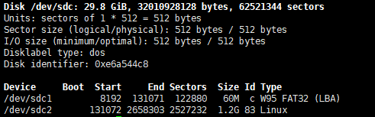
#1–2 Raspberry PI: OS Installation (4/4)
$ sudo fdisk –l
$ flash –u hypriotos-init.yaml –d /dev/sdc –f hypriotos-rpi-v1.9.0.img.zip
$ cd ~
And that’s it! Now HypriotOS is flashed to your MicroSD card.
Insert the SD card back to your Raspberry PI and boot it up.

Slide 21
Physical Inter-Connect test
iperf Client
iperf Client
iperf Server
Container
Docker
Runtime
VM
C
TCP Packet
KVM Hypervisor
Hypriot OS
Linux Ubuntu OS
Switch
Raspberry Pi Box
for IoT Sensors
& Actuators
NUC Box
for IoT-Cloud Hub

Slide 22
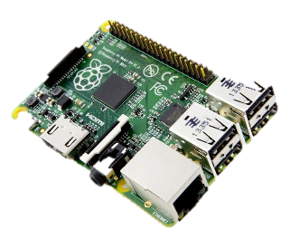
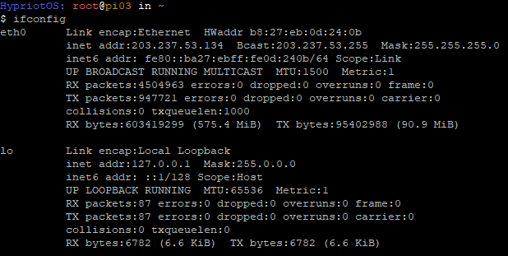
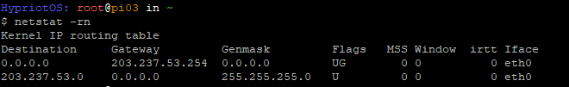
#2 Network Configuration:
Check Network & install packages
Check network interface configuration
$ ifconfig
Check routing table and install packages
$ netstat -rn
$ sudo apt-get update
$ sudo apt-get install -y openssh-server git vim

Slide 23
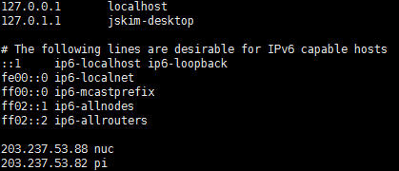
#4–1 Hostname preparation for Kafka (1/2)
Every machine which communicate with themselves must know their own address.
Edit /etc/hosts
$ sudo vi /etc/hosts
(For Example)
Add two lines which describe the IP address and hostname of devices
IP address
hostname

Slide 24
#4–1 Hostname preparation for Kafka (2/2)
Every machine which communicate with themselves must know their own address.
SSH access to your PI (ID: pirate, PW: hypriot)
$ ssh pirate@<your Raspberry PI IP Address>
Edit /etc/hosts
$ sudo vi /etc/hosts
(For Example)
Add two lines which describe the IP address and hostname of devices

Slide 25
#4–2 Verification for hostname preparation
After editing /etc/hosts, check the edit is correctly done
For NUC
$ sudo ping <Your NUC hostname>
$ sudo ping <Your Raspberry PI hostname>
For Raspberry PI
$ sudo ping <Your NUC hostname>
$ sudo ping <Your Raspberry PI hostname>
If it was successful, We can be sure that
NUC know its own hostname and Pi’s hostname and Pi also know its own hostname and NUC’s hostname.

Slide 26
Data inter-connect with Kafka: NUC-side configuration
You
Kafka broker cluster
Hypriot OS
Ubuntu Linux
Raspberry Pi
NUC

Slide 27
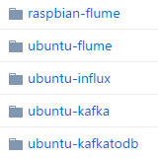
#5–1 Kafka deployment: Docker file download
Clone repository from Github
(http://github.com/SmartXBox/SmartX-mini)
$ cd ~
$ git clone https://github.com/SmartXBox/SmartX-mini.git
Folder List
In this section, we use this

Slide 28
#5–1 Download Files from Github
- Allocate Broker IDs and Ports
We’ll use a one zookeeper, 3 brokers and one consumer containers which share host’s public IP address
Zookeeper container doesn’t have broker id.
Each Broker has a unique id and port to interact each other.
Consumer container just used to manage topic and check the data from brokers.
Function(Container) Name | IP address | Broker id | Listening port
Zookeeper | Host’s public IP address | - | 2181
Kafka broker0 |  | 0 | 9090
Kafka broker1 |  | 1 | 9091
Kafka broker2 |  | 2 | 9092
Kafka consumer |  | - | -

Slide 29
#5–2 Kafka deployment: Edit Dockerfile
Check Dockerfile and Edit
$ cd ~/SmartX-mini/ubuntu-kafka
$ vim Dockerfile
FROM ubuntu:14.04
LABEL "maintainer"="Seungryong Kim <srkim@nm.gist.ac.kr>"
#Update & Install wget
RUN sudo apt-get update
RUN sudo apt-get install -y wget vim iputils-ping net-tools iproute2 dnsutils openjdk-7-jdk
#Install Kafka
RUN sudo wget --no-check-certificate https://archive.apache.org/dist/kafka/0.8.2.0/kafka_2.10-0.8.2.0.tgz -O - | tar -zxv
RUN sudo mv kafka_2.10-0.8.2.0 /kafka
WORKDIR /kafka

Slide 30
#5–2 Kafka deployment: Build Docker Image
Build Docker Image
$ cd ~/SmartX-mini/ubuntu-kafka
Build Dockerfile ※ It takes long time. You should type ‘.’ !
$ sudo docker build --tag ubuntu-kafka .
If you want to check Docker instruction words
$ docker --help
ex) docker ps : List containers
docker start : Start one or more stopped containers
docker rm : Remove one or more containers

Slide 31
#5–3 Kafka deployment: Place Docker Containers
(Recommend open new terminal window)
Run Docker Container
$ docker run -it --net=host --name [container name] ubuntu-kafka
We need to run 5 containers (zookeeper 1, broker 3, consumer 1)
Let’s assume the name of each containers,
zookeeper, broker0, broker1, broker2, consumer
Repeatedly type the above command with changing container name
If you want to look for more details about Docker command, see https://docs.docker.com/reference/commandline/

Slide 32
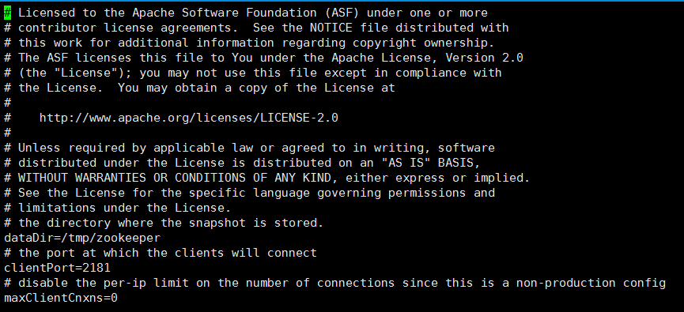
#6–1 Kafka Containers: Zookeeper configuration
-Zookeeper properties
We use default configuration
Open zookeeper properties file
# vi config/zookeeper.properties
Check the client port

Slide 33
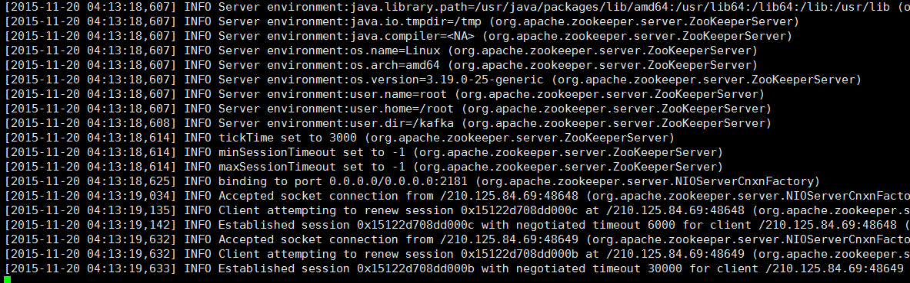
#6–2 Kafka Containers: Zookeeper executing
zookeeper must execute first (in Zookeeper container)
# bin/zookeeper-server-start.sh config/zookeeper.properties
(Leave Zookeeper running and open a new terminal for next tasks)

Slide 34
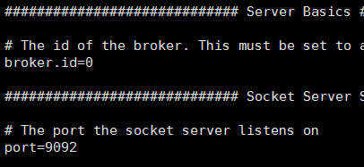
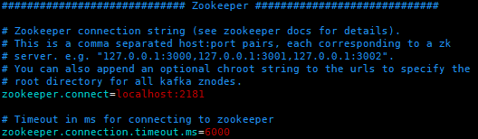
#6–3 Kafka Containers: Kafka Broker configuration
Create a Kafka container with the docker command before
$ sudo docker run -it --net=host --name [container name] ubuntu-kafka
Open server properties file and change proper broker id and port (they must be unique to each other) (Only for broker0,1,2)
# vi config/server.properties
Container Name | Broker id | Listening port
broker0 | 0 | 9090
broker1 | 1 | 9091
broker2 | 2 | 9092
consumer | - | -
broker id
port
Consumer container will not run any brokers
This is the code associated with the client port we just checked.

Slide 35
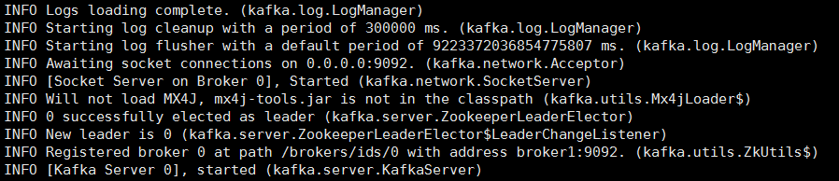
#6–4 Kafka Containers: Kafka Broker executing
Execute Kafka brokers (in broker0, broker1, broker2)
# bin/kafka-server-start.sh config/server.properties
Repeat previous steps for broker0, broker1, broker2
When it successfully works, each broker containers will show messages like the below

Slide 36
#6–5 Kafka Containers: Make Topic
Create topic (in Consumer container)
# bin/kafka-topics.sh --create --zookeeper localhost:2181 --replication-factor 1 --partitions 3 --topic resource
We can check topics.
Topic List
# bin/kafka-topics.sh --list --zookeeper localhost:2181
Topic specification
# bin/kafka-topics.sh --describe --zookeeper localhost:2181 --topic resource
resource

Slide 37
Data inter-connect with Kafka: PI-side configuration
You
Kafka broker cluster
Hypriot OS
Hypriot OS
Ubuntu Linux
Raspberry Pi
NUC

Slide 38
#7–1 Flume on Raspberry PI: File download
Git package is already installed in Hypriot OS
Clone all files from Github
(http://github.com/SmartXBox/SmartX-mini)
$ cd ~
$ git clone https://github.com/SmartXBox/SmartX-mini.git
Folder List
In this section, we use this file

Slide 39
#7–2 Flume on Raspberry PI: Net-SNMP installation
Update packages
$ sudo apt update
Download Net-SNMP
$ sudo apt install -y snmp snmpd snmp-mibs-downloader openjdk-8-jdk
Download MIBs
$ sudo download-mibs
Modify configuration file
$ sudo vi /etc/snmp/snmpd.conf
#rocommunity public localhost -> Delete #
$ sudo systemctl restart snmpd.service

Slide 40
#7–3 Flume on Raspberry PI: Flume installation
Edit Dockerfile
$ cd ~/SmartX-mini/raspbian-flume
$ vi Dockerfile
FROM balenalib/rpi-raspbian:stretch
LABEL "maintainer"="Seungryong Kim <srkim@nm.gist.ac.kr>"
RUN echo "Raspbian-flume"
#Update & Install wget, vim
RUN ["sudo","apt", "update"]
RUN sudo apt install -y wget vim iputils-ping net-tools iproute2 dnsutils openjdk-8-jdk
#Timezone
RUN sudo cp /usr/share/zoneinfo/Asia/Seoul /etc/localtime
#Install Flume
RUN sudo wget --no-check-certificate http://www.apache.org/dist/flume/1.6.0/apache-flume-1.6.0-bin.tar.gz -O - | tar -zxv
RUN mv apache-flume-1.6.0-bin /flume
ADD plugins.d /flume/plugins.d
ADD flume-conf.properties /flume/conf/
#Working directory
WORKDIR /flume

Slide 41
#7–3 Flume on Raspberry PI: Flume installation
Build Dockerfile ※ It takes long time. You should type ‘.’!
$ sudo docker build --tag raspbian-flume .
$ sudo docker run -it --net=host --name flume raspbian-flume
Check the configuration file (in Flume container)
# vi conf/flume-conf.properties
Modifying broker list
Default value sets “nuc”
Edit them into your own nuc’s hostname ( /etc/hosts )

Slide 42
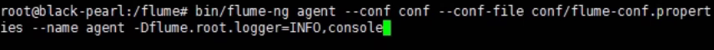
#7–4 Flume on Raspberry PI: Executing Flume agent
Run Flume on Rpi (in Flume container)
# bin/flume-ng agent --conf conf --conf-file conf/flume-conf.properties --name agent -Dflume.root.logger=INFO,console
If an error occurs, check the host of pi again.
When pi is rebooted, the information in /etc/hosts disappears.

Slide 43
Data inter-connect with Kafka: Verification
You
Kafka broker cluster
Hypriot OS
Hypriot OS
Ubuntu Linux
Raspberry Pi
NUC

Slide 44
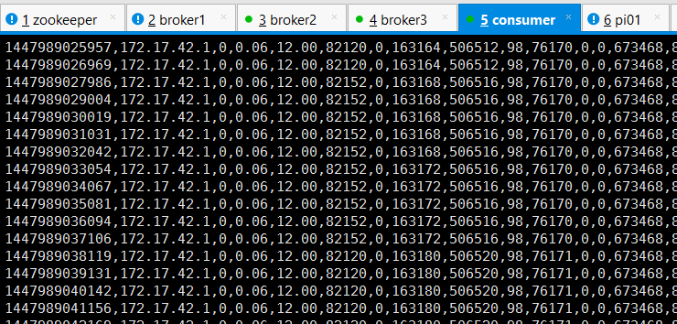
#8 Consume message from brokers
Launch consumer script on the Consumer container
$ bin/kafka-console-consumer.sh --zookeeper localhost:2181 --topic resource --from-beginning

Slide 45
Review

Slide 46
Lab Summary
With Inter-Connect Lab, you have experimented
How to physically inter-connect two kinds of Boxes (NUC and Raspberry PI)
How to inter-connect data transfer (via Kafka messaging) between functions located in different boxes
Differentiation between two types of “Inter-connect”: You need to distinguish physical Inter-connect from data Inter-connect!

Slide 47
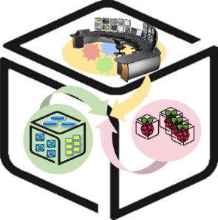
Thank You for Your Attention
Any Questions?
mini@smartx.kr

